Slide 1
"Unit 6: "For Live Session"
Chad Madding

Slide 2
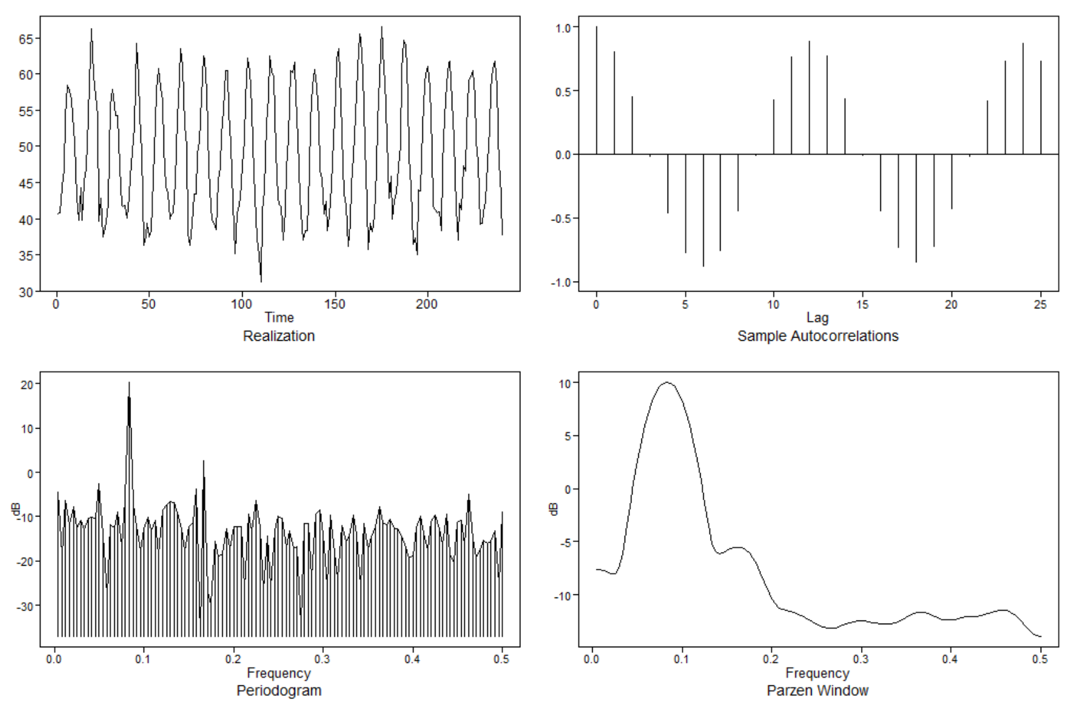
1. Looking at your time series from the first day of class, you addressed its stationarity before. Does either a signal plus noise, ARIMA, or ARUMA (seasonal) model seem appropriate?
Average Monthly Temperatures at Nottingham, 1920–1939
This is monthly temperature and looking at the plots to the right we can see the Autocorrelation peeking at 12 and 24, showing there may be some seasonality in the data. I am thinking an ARUMA model would be the best to start with on this data set.
#R Data
data(nottem)
plotts.sample.wge(nottem)

Slide 3
2. Copy and paste the factor table for a seasonal model with s = 7.
> factor.wge(c(rep(0,6),1))
Coefficients of Original polynomial:
0.0000 0.0000 0.0000 0.0000 0.0000 0.0000 1.0000
Factor Roots Abs Recip System Freq
1-1.0000B 1.0000 1.0000 0.0000
1+0.4450B+1.0000B^2 -0.2225+-0.9749i 1.0000 0.2857
1-1.2470B+1.0000B^2 0.6235+-0.7818i 1.0000 0.1429
1+1.8019B+1.0000B^2 -0.9010+-0.4339i 1.0000 0.4286

Slide 4
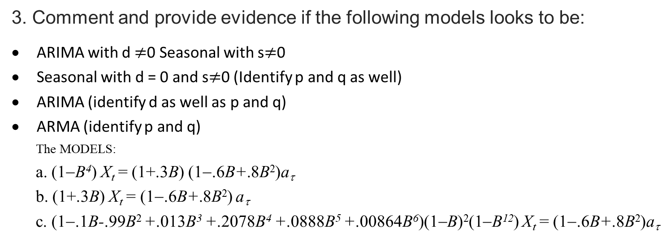
3. Comment and provide evidence if the following models looks to be:
ARIMA with d $≠$0 Seasonal with s$≠$0
Seasonal with d = 0 and s$≠$0 (Identify p and q as well)
ARIMA (identify d as well as p and q)
ARMA (identify p and q)
The MODELS:
a. (1−B⁴) X_{t} = (1+.3B) (1−.6B+.8B²)a_{τ}
b. (1+.3B) X_{t} = (1−.6B+.8B²) a_{τ}
c. (1−.1B-.99B² +.013B³ +.2078B⁴ +.0888B⁵ +.00864B⁶)(1−B)²(1−B¹²) X_{t} = (1−.6B+.8B²)a_{τ}

Slide 5
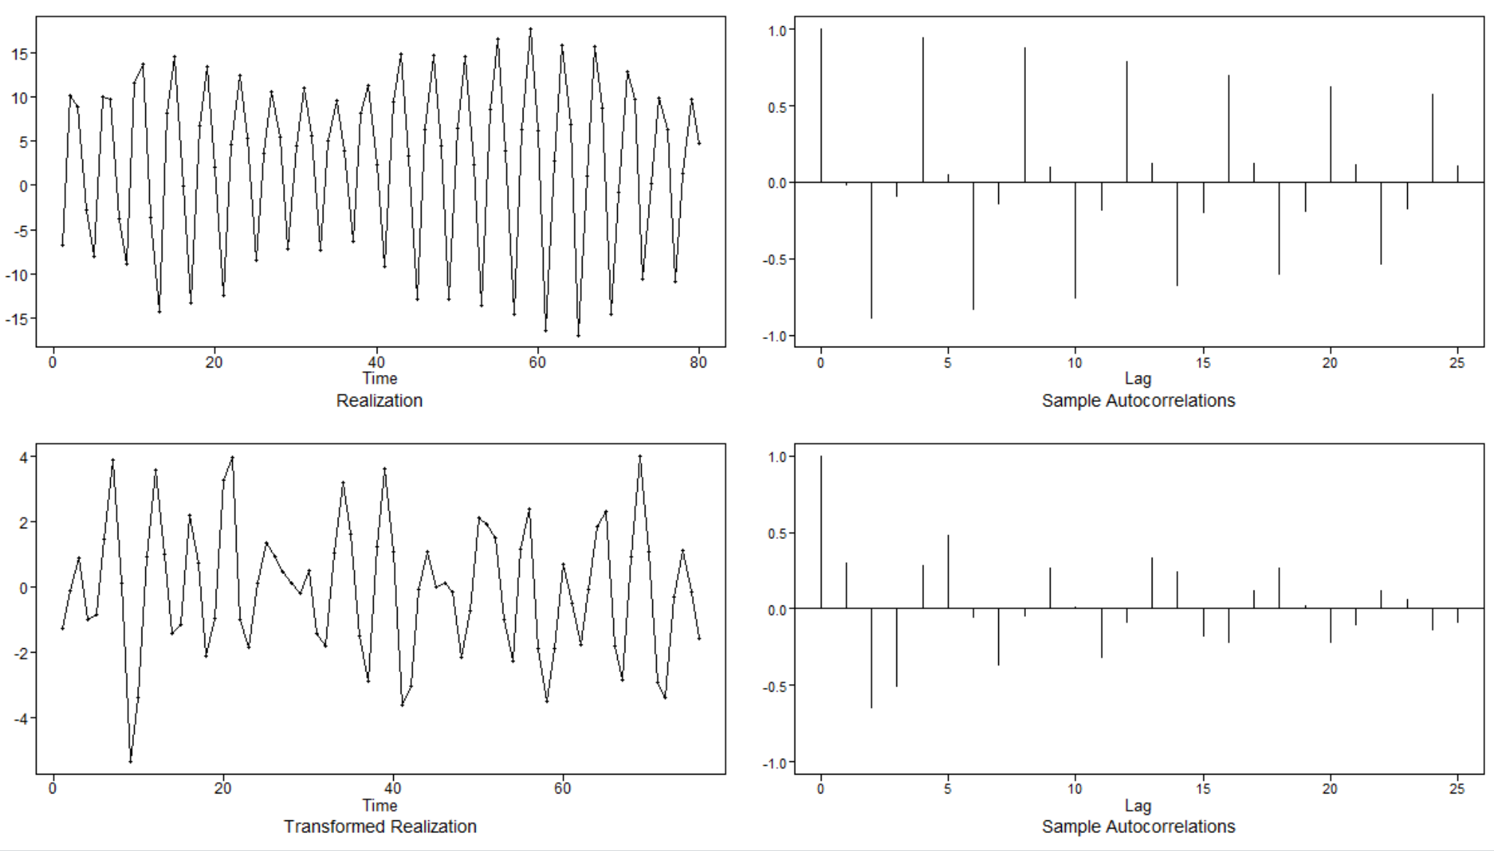
(1−B⁴) X_{t} = (1+.3B) (1−.6B+.8B²)a_{τ}
The above model looks to be seasonal with d = 0 and s=4 and come from an ARIMA(2,4,1).
# a. (1-B4) Xt = (1+.3B) (1-.6B+.8B2)at
x=gen.aruma.wge(n=80, phi = c(.6,-.8), theta = c(-.3), s=4, sn = 31)
Dif = artrans.wge(x,c(rep(0,3),1)) #Take out the (1-B^4)
aic5.wge(Dif) #Check the structure of the noise
Five Smallest Values of aic
p q aic
10 3 0 0.2352328
8 2 1 0.2374176
9 2 2 0.2534731
13 4 0 0.2552827
11 3 1 0.2584224

Slide 6
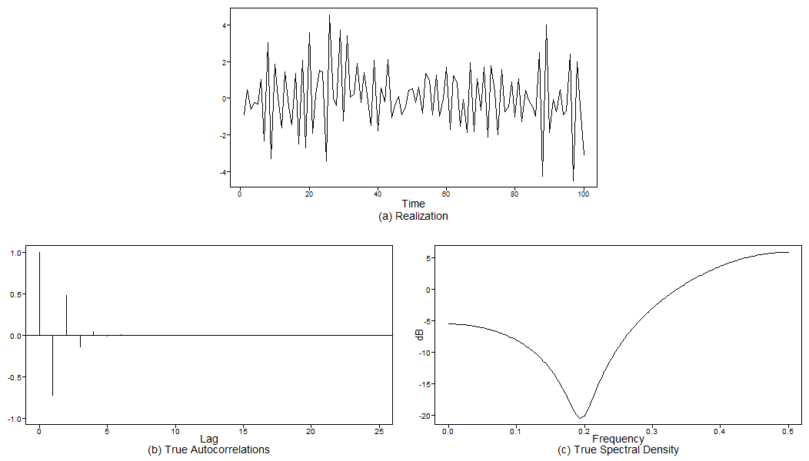
(1+.3B) X_{t} = (1−.6B+.8B²) a_{τ}
The above model is an ARMA(1,2).
# (1+.3B) Xt = (1-.6B+.8B2) at
plotts.true.wge(phi = c(-.3), theta = c(.6, -.8))
#AR
factor.wge(c(-.3))
#MA
factor.wge(c(.6,-.8))
#ARMA(1,2)
> #AR
> factor.wge(c(-.3))
Coefficients of Original polynomial:
-0.3000
Factor Roots Abs Recip System Freq
1+0.3000B -3.3333 0.3000 0.5000
> #MA
> factor.wge(c(.6,-.8))
Coefficients of Original polynomial:
0.6000 -0.8000
Factor Roots Abs Recip System Freq
1-0.6000B+0.8000B^2 0.3750+-1.0533i 0.8944 0.1956

Slide 7
(1−.1B-.99B² +.013B³ +.2078B⁴ +.0888B⁵ +.00864B⁶)(1−B)²(1−B¹²) X_{t} = (1−.6B+.8B²)a_{τ}
The above model seems to be an ARUMA(6,12,2)
# c. (1-.1B-.99B2 +.013B3 +.2078B4 +.0888B5 +.00864B6)(1-B)2(1-B12) Xt = (1-.6B+.8B^2)at
#AR
factor.wge(c(0.10, 0.99, -0.01, -0.2078, -0.888, -0.00864, 0.00, 0.00, 0.00, 0.00, 0.00, 0.00))
#MA
factor.wge(c(0.60,-0.80))
# (1-B)^2 (1+1.1453B) (1-1.9584B+1.1578B^2) (1+0.7033B+0.6681B^2) (1+0.0098B)Xt = (1-0.6B+0.8B^2)at
# ARUMA(6,12,2)
The AR Factor
Coefficients of Original polynomial:
0.1000 0.9900 -0.0100 -0.2078 -0.8880 -0.0086 0.0000 0.0000 0.0000 0.0000 0.0000 0.0000
Factor Roots Abs Recip System Freq
1+1.1453B -0.8731 1.1453 0.5000
1-1.9584B+1.1578B^2 0.8457+-0.3853i 1.0760 0.0680
1+0.7033B+0.6681B^2 -0.5263+-1.1044i 0.8174 0.3208
1+0.0098B -102.5435 0.0098 0.5000
The MA Factor
Coefficients of Original polynomial:
0.6000 -0.8000
Factor Roots Abs Recip System Freq
1-0.6000B+0.8000B^2 0.3750+-1.0533i 0.8944 0.1956

Slide 8
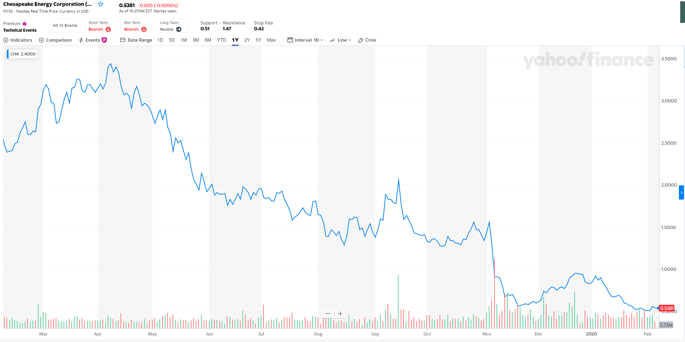
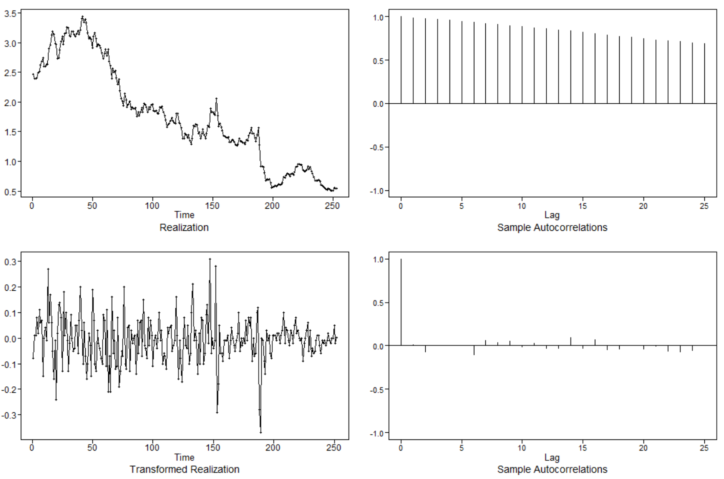
Last years’ worth of daily stock price data for Chesapeake Energy(CHK)
#Read in one year od Chesapeake Energy's stock data
library(readr)
CHK = read_csv("Unit06/CHK.csv")
head(CHK)
# Plot the data.
plot.ts(CHK$`Adj Close`)
# Take the first difference, and then estimate the structure of differenced data.
CHKarTrans = artrans.wge(CHK$`Adj Close`,phi.tr = 1)
acf(CHKarTrans)
# From this information, suggest a model for the data.
aic5.wge(CHKarTrans)
Looking at the above transformed realization and the sample Autocorrelations we can see that we are now working with stationary data.
After taking the first difference, and then estimating the structure of differenced data we ended up with a good signal to run the AIC through. The table suggests that an ARIMA(0,1,0) would be a good choice to start with.
Five Smallest Values of aic
p q aic
1 0 0 -4.801930
2 0 1 -4.794097
4 1 0 -4.794083
5 1 1 -4.792513
3 0 2 -4.790841

Slide 9
A brief reflection of thoughts and key takeaways – Week 6
ARIMA Models
The (1 − B)^{d} factor dominates the stationary components.
In the realizations
Autocorrelations
Spectral densities all have peaks at f = 0
For d > 1, this domination is even more striking.
The true autocorrelations are equal to 1 for all k.
The sample autocorrelations will always damp (in part because of the way they are calculated).
Slowly damping sample autocorrelations is an indication of ARIMA data.
“Quarterly” behavior
The spectral estimate has peaks at f = 0, .25, and .5
gen.aruma.wge to generate realizations from seasonal models
Question:
I am nowhere close to feeling conformable with using factor tables to determine what the model. I do not think any of the answers in question 3 are what you are looking for. I also did the homework and I was unable to work out 5.5.
Would you please provide a more broken out explication of using the factor tables on seasonal data? I think I have just missed it completely. Thanks
Below is an example. The first is a factor table for the (1-B^5) the other is the ARUMA(5,1,0). I get the 1 and 0 but do not see how the two “5” tables work.
> factor.wge(c(0,0,0,0,1)) #(1-B^5)
Coefficients of Original polynomial:
0.0000 0.0000 0.0000 0.0000 1.0000
#Factor Table for (1-B^5)
Factor Roots Abs Recip System Freq
1+1.6180B+1.0000B^2 -0.8090+-0.5878i 1.0000 0.4000
1-0.6180B+1.0000B^2 0.3090+-0.9511i 1.0000 0.2000
1-1.0000B 1.0000 1.0000 0.0000
> factor.wge(phi = c(.5,-.3,.95,-.3,.35,-.2))
Coefficients of Original polynomial:
0.5000 -0.3000 0.9500 -0.3000 0.3500 -0.2000
#Factor Table for ARUMA(5,1,0)
Factor Roots Abs Recip System Freq
1-1.0000B 1.0000 1.0000 0.0000
1+1.0000B+0.8000B^2 -0.6250+-0.9270i 0.8944 0.3444
1+0.0000B+0.5000B^2 0.0000+-1.4142i 0.7071 0.2500
1-0.5000B 2.0000 0.5000 0.0000

